Slide 1
Progress Report: VISA Communication Tool
Group 64 • 12.5.2017
Wenbo Hou, Chenliang Wang

Slide 2
Review
Wenbo Hou
Expected delivery
Python Based VISA Communication Software
Project Objectives
Coding in Python
Graphic User Interface
Code Complete Feature
Querying Tool
Instrument Operations

Slide 3
Work Done
Wenbo Hou
Proposed Objectives
Code Complete
Querying Algorithm
Querying Source
Icon Set associated with Command Set
Querying Tool
Separate Window
Querying Source
Querying Algorithm

Slide 4
Progress - Code Complete Wenbo Hou
Property
Implement QCompleter
Dynamically Allocated Reference
Different Icon groups
Triggered when typing letters in

Slide 5
Progress - Query Tool Wenbo Hou
Property
Separate Class
Linkable to other events
Workflow
Trigger by signal
Open new window
Take input
Return Query Result
Notes:
g

Slide 6
Current Progress
Wenbo Hou
Communication Layer
Send Commands to the instrument
Query from the instrument
Run a script
Error Reporting

Slide 7
Progress - Communication Wenbo Hou
Configure Environment
Implement PyVISA
Install NI-VISA
The standard VISA communication Library
Configure Global Path
Device Connection
Device Type: DPO 4043
Connect the instrument through Device-USB Cable
Notes:
g

Slide 8
Progress - Communication Wenbo Hou
Initial Instrument Driver
Locate Device
Use ResourceManager
Find all connected instruments
Open Specific instrument
Initial Driver for future operations
Notes:
g

Slide 9
Progress - Communication Wenbo Hou
Operations
Send instructions and Query
Implement PyVISA write()
Implement PyVISA query()
Error Information
No Device Connected
Invalid Instructions
Notes:
g

Slide 10
My Tasks of Project
Chenliang Wang
GUI Design
GUI Implement
Sent Command History
IP connection (need to test)
Chenliang Wang

Slide 11
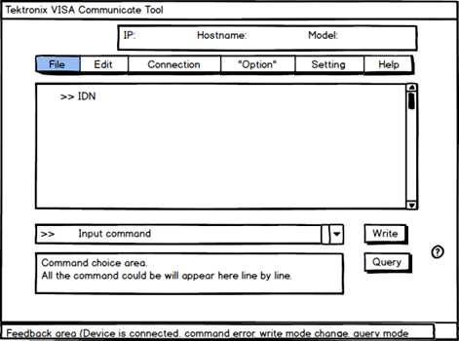
Progress Chenliang Wang
GUI Design
Notes:
g

Slide 12
Progress Chenliang Wang
GUI implement (part)
Enveriment
Pycharm + Python 3.6 + PyQt 5.71

Slide 13
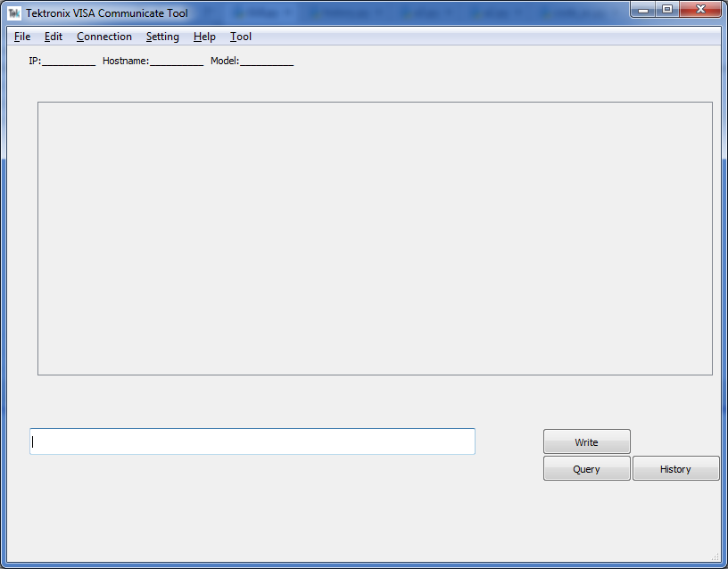
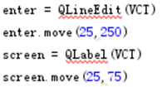
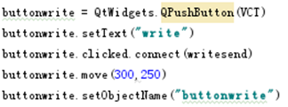
Progress Chenliang Wang
GUI implement
Navigation bar
Send command with query or write.

Slide 14
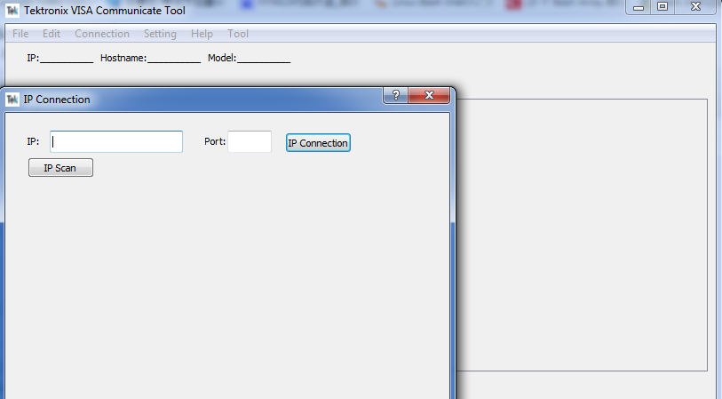
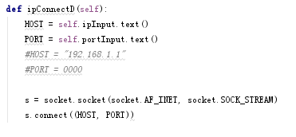
Progress Chenliang Wang
GUI implement
IP connection

Slide 15
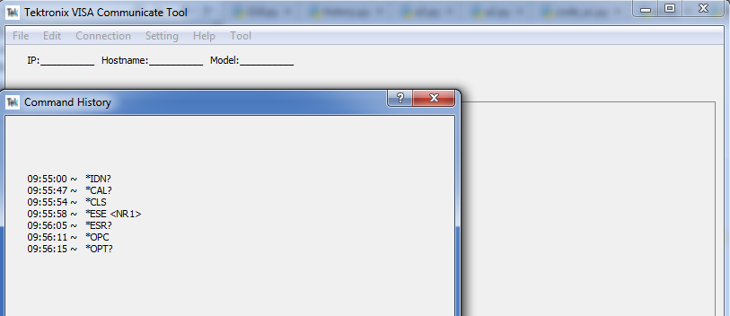
Progress Chenliang Wang
GUI implement
Sent Command History
Time of command sent

Slide 16
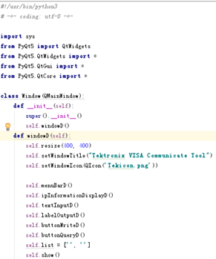
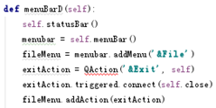
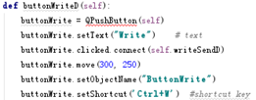
Progress Chenliang Wang
GUI implement
Code Organize

Slide 17
Road block Chenliang Wang
What is the problem
Miss group member.
One member left at begin of this term.
Time limited.
⅓ job in these couple weeks.
Technology less.
Hard for project during the process.

Slide 18
Conclusion
The current software

